Slide 1
National Quality Improvement Center for Adoption/Guardianship Support and Preservation (QIC-AG)
A Program of Spaulding for Children
in Partnership with
The University of Texas at Austin,
The University of Wisconsin-Milwaukee, and
The University of North Carolina at Chapel Hill

Slide 2
QIC-AG partnership
QIC-AG is funded through a cooperative agreement with Department of Health and Human Services, Administration for Children and Families, Children’s Bureau. The partnership includes:
Spaulding for Children
Lead Contact: Melinda Lis
The University of Texas at Austin
Lead Contact: Dr. Rowena Fong
The University of Wisconsin-Milwaukee
Lead Contact: Dr. Nancy Rolock
The University of North Carolina at Chapel Hill
Lead Contact: Dr. Mark Testa

Slide 3
QIC-AG Goal
The QIC-AG will develop evidence-based models of support and intervention that can be replicated or adapted in other child welfare systems to achieve long-term, stable permanency in adoptive and guardianship homes for waiting children as well as for children and families after adoption or guardianship has been finalized.

Slide 4
Expected Long-Term Outcomes
Increased post-permanency stability
Improved behavioral health for children
Improved child and family well-being

Slide 5
QIC-AG OBJECTIVES
1. Build a body of knowledge of the combinations of supports, services, and interventions that work best to ensure resiliency and stability for children in permanent homes.
2. Assist sites to develop innovative, collaborative, culturally responsive and effective practices that address the needs of the target populations.
3. Assist sites to develop appropriate interventions and service-delivery mechanisms that match the needs of children and their adoptive parents or legal guardians and ensure ongoing stability and enhanced well-being.

Slide 6
QIC-AG OBJECTIVES
4. Assist sites to conduct comprehensive screening and functional assessments of children to ensure appropriate service intervention. Services will be available, accessible, culturally responsive, and effective to meet behavioral/mental health needs.
5. Develop, in partnership with the selected sites, a system of culturally responsive evidence-based services that improve permanency and stability outcomes for children in adoptive or guardianship homes; meet the target population's needs; and extend post-permanency supports and services to the post-adoption and guardianship population.
6. Conduct an evaluation on selected sites and produce new, evidence-based models of support and intervention that increase resiliency and assure permanency and stability for children in adoptive and guardianship homes.

Slide 7
Continuum of Services & Supports
Child welfare agencies should provide a continuum of services to increase permanency stability and support, beginning when children first enter the child welfare system and continuing after adoption or guardianship has been finalized.
Pre-Permanency: Services and supports that engage, prepare, and connect families to services prior to finalization of adoption or guardianship. Pre-permanency services focus on increasing resiliency and ensuring permanency and placement stability. These services focus on emotional-behavioral health issues and provide caregivers with education that improves their capacity to support stable permanency once adoption or guardianship has been finalized.
Post-Adoption or Guardianship: Services and supports that increase resiliency, placement stability and the capacity of caregivers to meet the needs of children in their care. Services are targeted to the transitions and changing developmental and emotional needs associated with this population. Recognizing that services targeted at families in crisis may be too late, these services target children and families at the earliest signs of difficulty.

Slide 8
adoption-competency
“The new catch phrase is 'adoption-competency' but what does that really mean? I need services that help me understand the impact trauma has on my children and how I can change my parenting paradigm to effectively meet their needs. As an adoptive parent, it is difficult to meet the children's complex needs and almost impossible if you don’t know what services to look for or who to call for help.” – Quote from an adoptive parent

Slide 9
Theory of Change
Services need to be provided early.
Interventions targeting adoptive or guardianship homes nearing disruption and dissolution are often provided too late.
Services should target the earliest sign of difficulty.
Preparation should begin prior to finalization and equip families with the capacity to weather unexpected difficulties and seek services and supports.
Identify families most at risk.
Research has shown predictors of post-permanency instability that can be assessed to determine which families to target for post permanency instability.
Regular check-ins can identify families most at risk of instability and in need of services.
Services should be evidence-supported.
Appropriate services should be culturally-responsive models that are tested to determine their effectiveness and can be replicated with fidelity.
Well-conducted RCTs measure important outcomes and distinguish services that produce sizable effects from those that do not.

Slide 10
Target populations to be served
Target Group 1: Children awaiting adoptive or guardianship placements, or children who are in identified adoptive or guardianship homes but the placement has not resulted in finalization for significant time due to the children’s challenging mental health, emotional, or behavioral issues.
Target Group 2: Children and their adoptive or guardianship families who have already finalized the adoption or guardianship and for whom stabilization may be threatened. This target group includes children who have obtained permanency through private guardianship or private adoptions, both domestic and international.

Slide 11
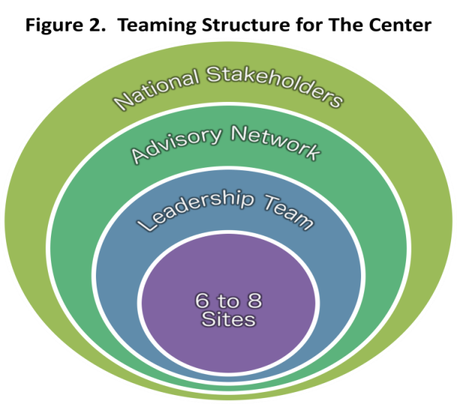
QIC-AG teaming structure

Slide 12
Advisory Board
Dr. Mark F. Testa Advisory Board Chair University of North Carolina at Chapel Hill
Mary Bissell Child Focus
Veenod Chulani, MD
Orlando Health
Hope Cooper True North Group
Heidi Cox Gladney Center for Adoption
Dr. Joseph Crumbley Trainer, Consultant and Therapist
April Curtis Be Strong Families
Dr. Angelique Day Wayne State University
Kathy Deserly Capacity Building Center for Tribes
Heather Forbes Beyond Consequences Institute
Deborah Gray Nurturing Attachments
John Johnson Tennessee Department of Children's Services
Robert Johnson Annuity Company
Joe Kroll North American Council on Adoptable Children
Shaun Lane Hephzibah Children's Association
Judge Cindy Lederman Eleventh Judicial Circuit of Florida
Dr. Sharon McDaniel A Second Chance
Hollee McGinnis Doctoral Candidate, Washington University
Kathleen McNaught American Bar Association Center on Children and the Law
Dr. Avidan Milevsky Kutztown University of Pennsylvania
Dr. Peter Pecora The University of Washington and Casey Family Programs
Frank Perfinski Delaware Department of Services for Children, Youth and Their Families
Dr. Bruce Perry ChildTrauma Academy
Russell Pretz Former Intern Congressional Coalition on Adoption Institute
Dr. Scott Ryan The University of Texas at Arlington
Dr. Gina Samuels The University of Chicago
Karyn Schimmels Camp to Belong
Marty Shannon Utah Department of Human Services
Michael Shaver Children's Home Society of Florida
Dr. Kristen S. Slack The University of Wisconsin-Madison
Pam Wolf Harmony Family Center

Slide 13
Site selection
Six to eight sites (state, county or tribal child welfare system) will be selected to take part in a national project designed to promote permanency and improve adoption and guardianship preservation and support.
Sites will work in partnership with the QIC-AG to implement and evaluate a continuum of services that support the permanence and stability of children in adoptive and guardianship homes.
QIC-AG will provide sites with financial resources, intensive technical assistance and support throughout the initiative.

Slide 14
Site selection
Children Bureau’s Guidelines:
Two or three of the sites with greater than 10,000 children in substitute care.
At least one site with fewer than 5,000 children in substitute care.
Urban and rural jurisdictions
Binding work agreements will govern the relationships between sites and the QIC-AG and must be executed with state or county public child welfare agencies or tribes.
Sites will be selected in late spring/early summer 2015.

Slide 15
Overview of Selection Process
Sites will be identified through intensive assessment and preliminary research conducted by QIC-AG.
Preliminary conversations will take place with sites to discuss potential collaboration including: detailed discussion of the initiative; benefits of being a selected site and; site specific programs, services, and capacity currently in place, and in need of development.
After the initial assessment, sites will be identified to participate in the full assessment process. This process will focus on obtaining foundational knowledge of each site’s continuum of services and readiness to participate in this initiative.

Slide 16
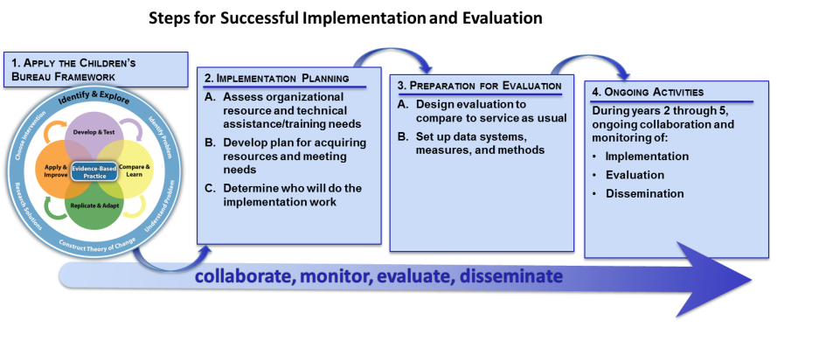
Implementation & Evaluation steps

Slide 17
“Post permanency supports are critical to the stability and well-being of adoptive families. My husband and I love our adopted child but she came to us having experienced a lot of trauma which will take years and many resources to heal.”- Jennifer, Adoptive Parent
Spaulding for Children and all of its partners are excited to be part of this critical initiative.
We believe that the knowledge gained from the initiative will help child welfare agencies across the nation redefine their systems so that they provide a continuum of services that promote permanency and stability for children in custody and provide stability and support for children and families post-permanency.

Slide 18
Follow up
Sites that are interested in obtaining more information about this initiative should contact Melinda Lis at:
mlis@spaulding.org or 773-848-6880
Funded through the Department of Health and Human Services, Administration for Children and Families, Children’s Bureau, Grant #90CO1122-01-00. The contents of this publication do not necessarily reflect the views or policies of the funders, nor does mention of trade names, commercial products or organizations imply endorsement by the U.S. Department of Health and Human Services. This information is in the public domain. Readers are encouraged to copy and share it but please credit Spaulding for Children.

